Slide 1

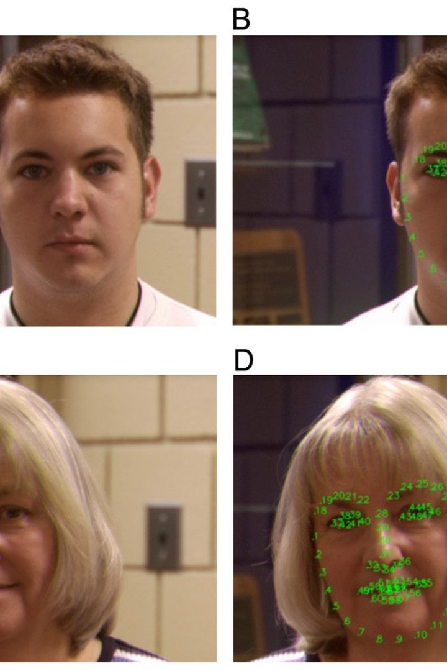

Innovative Face Detection and Recognition Student Attendance System
A novel Face Detection and Recognition Student Attendance System is proposed to streamline administrative tasks and enhance classroom efficiency. As the administrator, you oversee the system's implementation and functionality, facilitating seamless communication between teachers and students.
Through the system, you can issue notices to both teachers and students, ensuring important information reaches the intended recipients promptly. Additionally, teachers can utilize the system for conducting tests and promptly generating results, fostering an environment conducive to academic progress. By leveraging facial recognition technology, the system not only automates attendance tracking but also enhances security measures within the educational institution.

Slide 2
Streamlined Communication and Information Dissemination
Efficient Notices 📩
Real-time Updates 📲
Targeted Communication 🎯
The system enables administrators to issue notices to both teachers and students in a timely manner, ensuring important information reaches the intended recipients promptly.
Facilitates seamless communication between administrators, teachers, and students, ensuring that everyone is informed and connected in real-time.
Allows for the customization of communication channels to ensure that relevant information reaches specific individuals or groups efficiently.

Slide 3

Academic Progress and Efficient Testing
1
Automated Testing 📝
Teachers can conduct tests using the system, which allows for prompt generation of results, fostering an environment conducive to academic progress.
2
Real-time Results 📊
Teachers have access to real-time test results, enabling them to provide timely feedback to students and adapt teaching strategies accordingly.
3
Performance Analysis 📈
Facilitates the analysis of student performance trends, enabling educators to implement targeted interventions for academic improvement.

Slide 4

Enhanced Security Measures
1
Automated Attendance Tracking 🔒
2
Access Control 🛡️
3
Identification Verification ✅
Ensures secure access to restricted areas, contributing to a safe and protected environment for students and staff.
Facial recognition technology provides reliable identification verification, bolstering the overall security infrastructure of the institution.
The system utilizes facial recognition technology to enhance security measures within the educational institution by automating attendance tracking.

Slide 5
Revolutionizing Administrative Processes
Efficiency 🚀
Transparency 🌐
Compliance 📑
The system streamlines administrative tasks, saving time and resources while ensuring smoother operations and improved productivity.
Brings transparency to administrative processes, providing insights and data-driven decision-making capabilities for educational administrators.
Ensures adherence to regulations and protocols, offering a high level of compliance and accountability in administrative procedures.

Slide 6




Automated Task Management
Attendance Automation ⏰
Efficient Information Storage 🗄️
Seamless Reporting 📊
Generates comprehensive reports and data summaries to streamline administrative reporting and decision-making processes.
Automates the attendance tracking process, saving time and reducing the administrative burden on staff members.
Automatic saving of necessary information in an organized manner, ensuring easy access and retrieval when needed.

Slide 7
Training Database and Compliance
Authorized Student Faces
The system is trained with the faces of authorized students cropped and stored in a database with appropriate labels.
Compliance Assurance
Ensuring compliance with data protection regulations and privacy laws through secure and authorized access to the training database.
Data Management
Automatic saving of necessary information and attendance details in a secure manner, ensuring data integrity and privacy compliance.

Slide 8
Promotion of Dynamic Learning Environment
3
7K
30
Interactive Learning
Enhanced Engagement
Efficiency Improvement
Facilitates interactive learning experiences through innovative technology integration.
Promotes enhanced student engagement through technological advancements in educational administration.
Drives a significant improvement in administrative efficiency and resource allocation within educational institutions.

